Slide 1
Attention U-Net :
Learning Where to Look for the Pancreas
Abstract:
propose a novel attention gate (AG) model for medical imaging that automatically learns to focus on target structures of varying shapes and sizes.
Models trained with AGs implicitly learn to suppress irrelevant regions in an input image while highlighting salient features useful for a speciﬁc task.
AGs can be easily integrated into standard CNN architectures such as the U-Net model with minimal computational overhead while increasing the model sensitivity and prediction accuracy.
The proposed Attention U-Net architecture is evaluated on two large CT abdominal datasets for multi-class image segmentation.

Slide 2
问题的提出
Fully convolutional networks and the U-Net are two commonly used architectures. Despite their good representational power, these architectures rely on multi-stage cascaded CNNs when the target organs show large inter-patient variation in terms of shape and size. Cascaded frameworks extract a region of interest (ROI) and make dense predictions on that particular ROI.
But this approach leads to excessive and redundant use of computational resources and model parameters; for instance, similar low-level features are repeatedly extracted by all models within the cascade.
To address this general problem, we propose a simple and yet effective solution, namely attention gates (AGs).

Slide 3
创新
1. proposing grid-based gating that allows attention coefficients to be more specific to local regions.
2. We propose one of the first use cases of soft-attention technique in a feed-forward CNN model applied to a medical imaging task. The proposed attention gates can replace hard attention approaches used in image classification [36] and external organ localisation models in image segmentation frameworks.
3. An extension to the standard U-Net model is proposed to improve model sensitivity to foreground pixels without requiring complicated heuristics.

Slide 4
补充
Soft Attention：
传统的Attention Mechanism就是Soft Attention,即通过确定性的得分计算来得到attended之后的编码隐状态。Soft Attention是参数化的（Parameterization），因此可导，可以被嵌入到模型中去，直接训练。梯度可以经过Attention Mechanism模块，反向传播到模型其他部分。
Hard Attention：
相反，Hard Attention是一个随机的过程。Hard Attention不会选择整个encoder的隐层输出做为其输入，Hard Attention会依概率Si来采样输入端的隐状态一部分来进行计算，而不是整个encoder的隐状态。为了实现梯度的反向传播，需要采用蒙特卡洛采样的方法来估计模块的梯度。

Slide 5
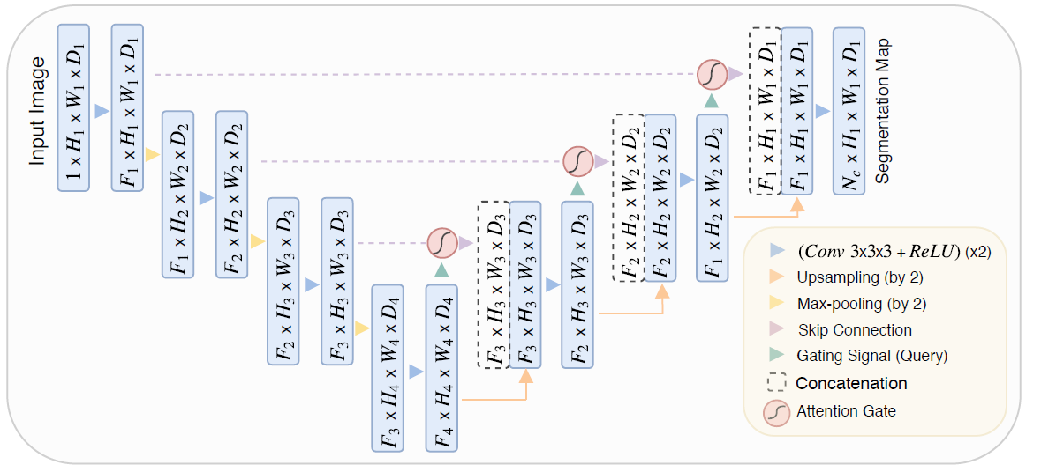

Slide 6
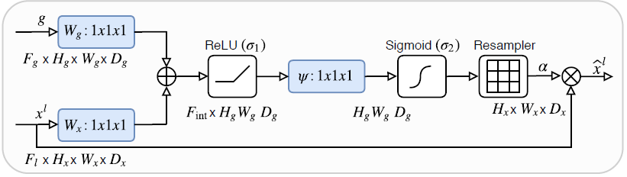


Slide 7

The update rule for convolution parameters in layer l-1can be formulated as follows:

Slide 8
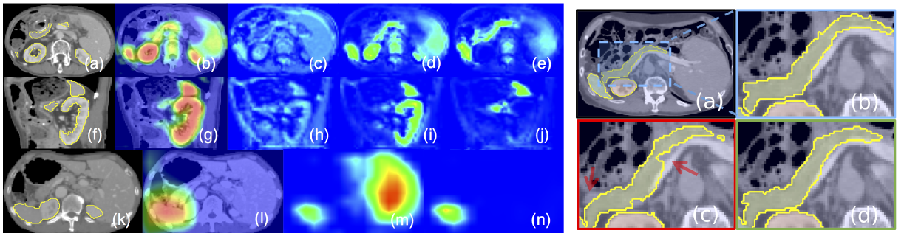
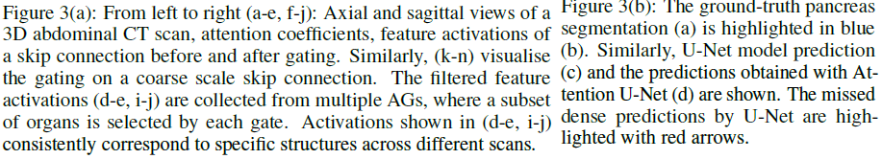

Slide 9
Experiments and Result
Evaluate the Attention U-Net model on a challenging abdominal CT multi-label segmentation problem.
In particular, pancreas boundary delineation is a difﬁcult task due to shape-variability and poor tissue contrast
Evaluation Datasets：two different CT abdominal datasets are used(CT-150/CT-82)
Implementation Details:
· propose a 3D-model to capture sufﬁcient semantic context
· batch sizes of 2 to 4 samples
· Adam optimizer、 batch-normalisation、 standard data-augmentation techniques
· using the Sorensen-Dice loss
· be less sensitive to class imbalance
· gating parameters are initialised
评价指标：
· Dice scores (DSC)
· surface distances (S2S)
· pancreas predictions
· trainable parameters(代表模型的容量)

Slide 10
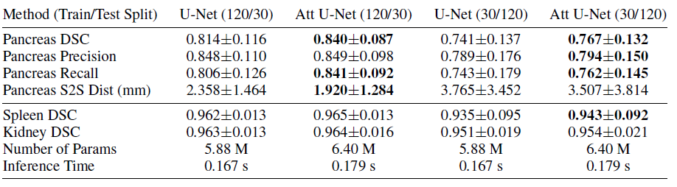

CT-150 dataset for both training (120) and testing (30)

Slide 11
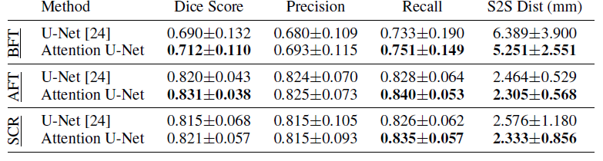
The dataset contains in total 82 scans which are split into training (61) and testing (21) sets

Slide 12
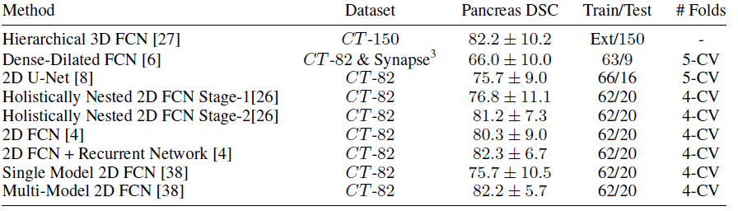
Results from state-of-the-art CT pancreas segmentation models are summarised in Table 4 for comparison purposes.

